Slide 1

National Infrastructure Database-Modernized
By:
Duru Elli
Jordan Stella
Mohammed Aishat

Slide 2

The Problem
Tracking Infrastructure Projects
Uncorrelated Data
Budgeting Delays

Slide 3
Centralization Matters
Single Source of Truth
Faster Decision Making
Reduced Errors
Efficient Oversight

Slide 4
project Goals
Rational Databases
XML & JSON Compatible
Integrated Website
Maximize Transparency

Slide 5
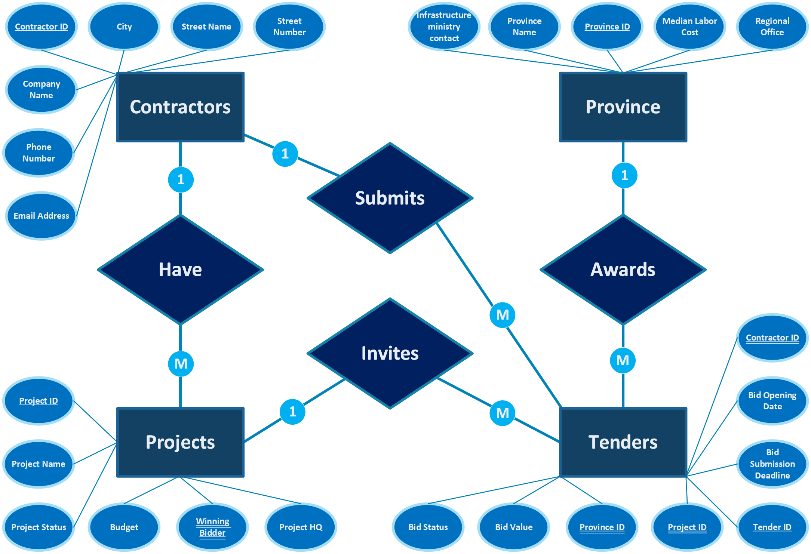
Overview

Slide 6
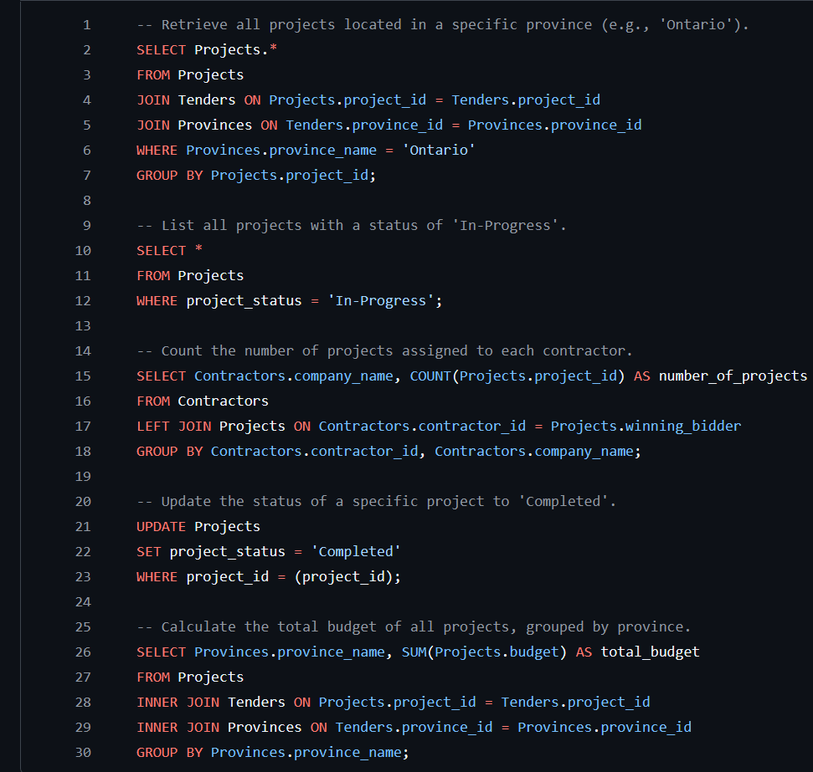
SQL Demo:
Key Queries

Slide 7
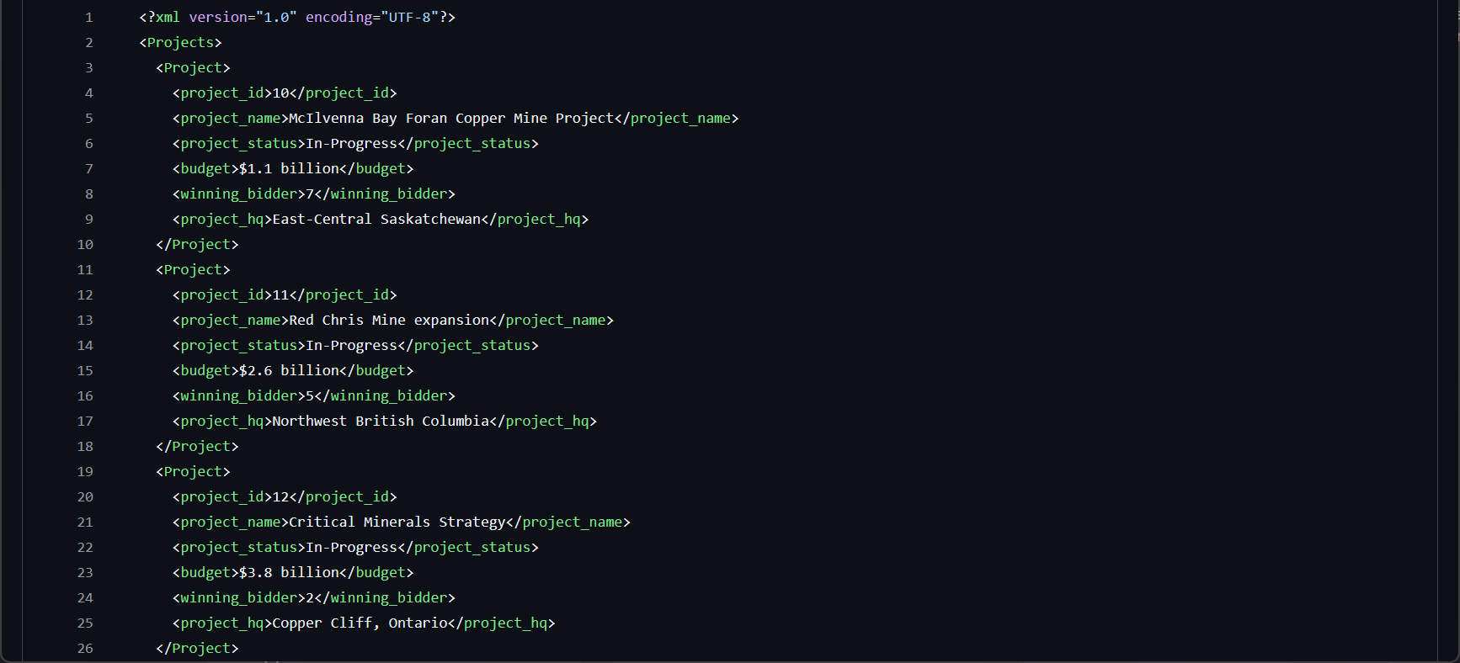
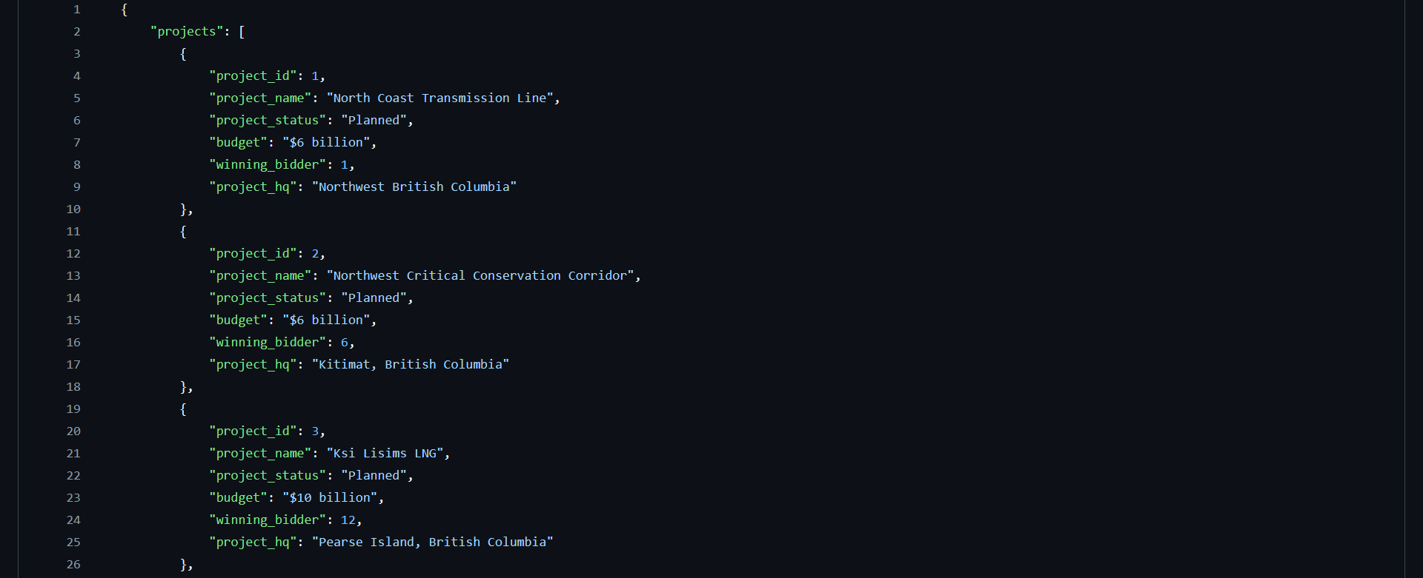
Project Data:
In Progress Projects
(XML)
Planned Projects
(JSON)

Slide 8
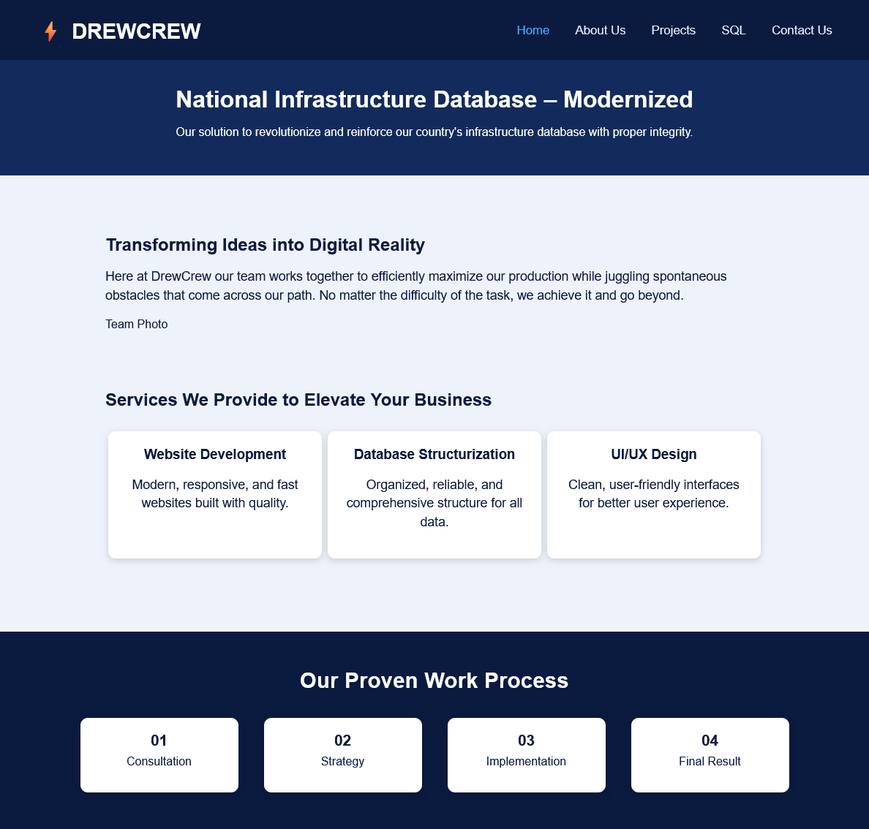
Proof of Concept:
Webpage

Slide 9

Proposed Solution
Centralized System
Clearly Organized Data
Visually Comprehensible

Slide 10

QUESTIONS

